Slide 1
MAX : A Multicore-Accelerated File System for Flash Storage
Xiaojian Liao, Youyou Lu, Erci Xu, Jiwu Shu,
In 2021 USENIX Annual Technical Conference
2021. 08. 30
Presentation by Han, Yejin
hyj0225@dankook.ac.kr
Notes:
Let me begin my presentation.
Today I will give a presentation on “Fully Automatic Stream Management for Multi-Streamed SSDs Using Program Contexts”

Slide 2
Introduction
Motivation
MAX
4-1. RPS
4-2. file cell
4-3. mlog
Evaluation
Conclusion
Notes:
This is the outline on my talk.
First, I will describe garbage Collection overhead in SSDs and Multi-Streamed SSD
Then, the details of PCStream design and analysis results are presented.
Finally, I will conclude my talk.

Slide 3
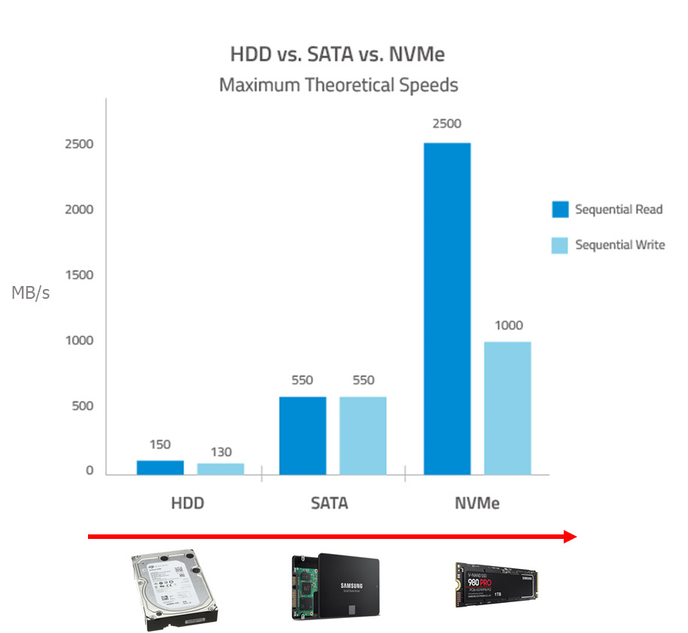
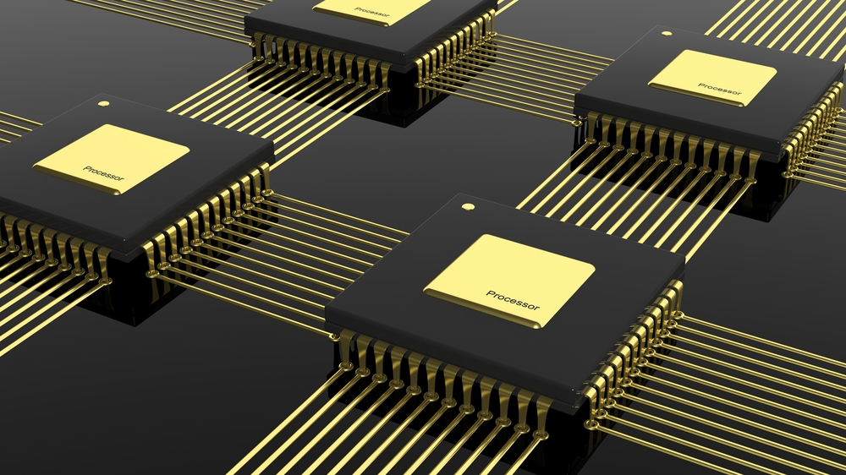
1. Introduction
The bandwidth of modern storage hardware has been surging in recent years
Employing multicores for high bandwidth becomes a must

Slide 4
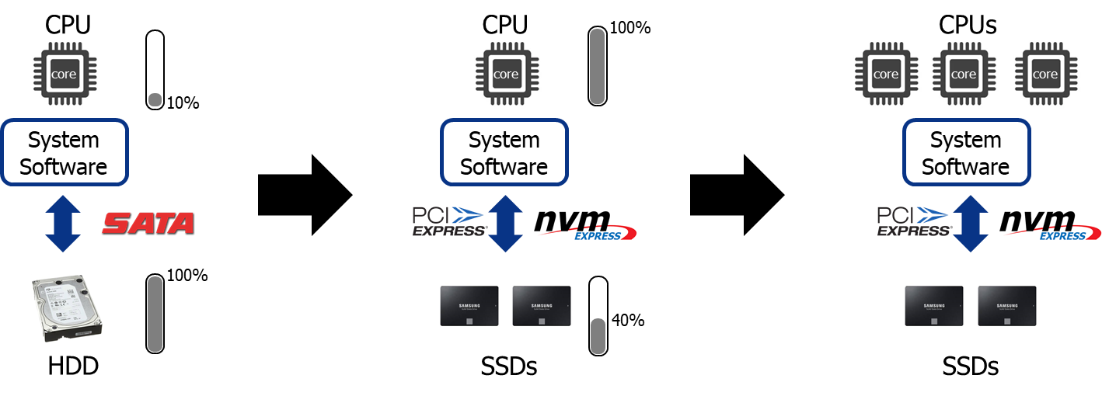
1. Introduction
Employing multicore CPUs for high bandwidth
Notes:
NVM은 DRAM보다 용량이 크고 storage보다 속도가 빠르다. 영구적인 데이터를 접근할 때 메모리에 접근할 때처럼 byte단위로 접근이 가능하다 그래서 메모리와 스토리지 간의 페이지 블록 단위의 접근을 없앨 수 있다.

Slide 5
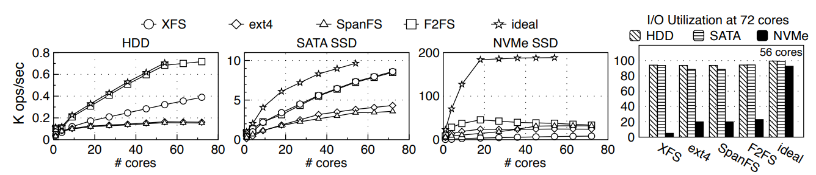
2. Motivation
Multicore scalability problem
Workload: create(), write(), fsync(), unlink()
Ideal: partition the drive and run an independent F2FS on each partition
Others: multiple CPU cores share a single drive partition
Most file systems scale well on traditional storage devices
Notes:
DRAM과 PCM, NAND간의 속도차이가 몇배가 나는지 설명

Slide 6

2. Motivation
Multicore scalability problem
Workload: create(), write(), fsync(), unlink()
Ideal: partition the drive and run an independent F2FS on each partition
Others: multiple CPU cores share a single drive partition
Most file systems scale well on traditional storage devices
Cannot efficiently utilize the bandwidth
of high performance drives!!!
Notes:
DRAM과 PCM, NAND간의 속도차이가 몇배가 나는지 설명

Slide 7




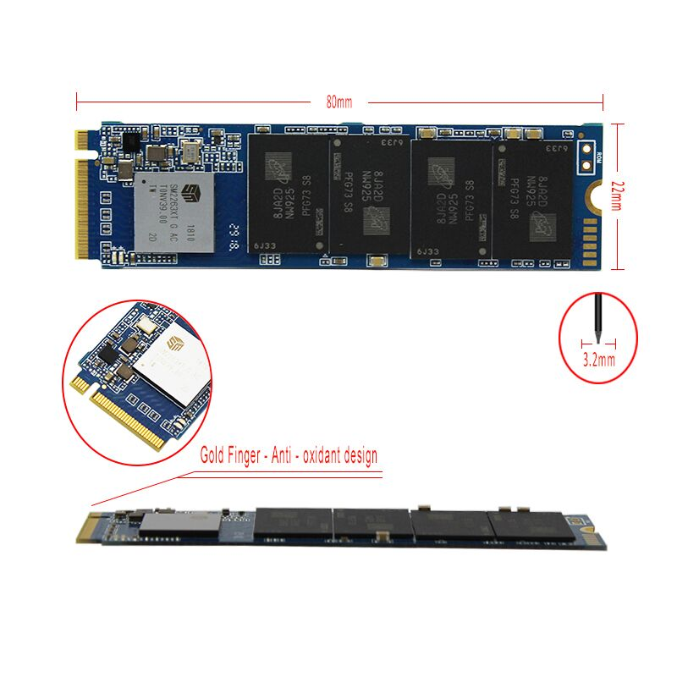
2. Motivation
Multicore scalability problem: File system
core
core
core
core
Concurrent I/Os and
Multicore CPUs
Multi-queue block device
Multicore-friendly
Design of block layer
And device driver
NVMe controller
High internal data
Parallelism of the SSD
flash
flash
flash
flash
Notes:
DRAM과 PCM, NAND간의 속도차이가 몇배가 나는지 설명

Slide 8

2. Motivation
Multicore scalability problem: File system
core
core
core
core
Concurrent I/Os and
Multicore CPUs
File System
File system becomes the scalability bottleneck
Multi-queue block device
Multicore-friendly
Design of block layer
And device driver
NVMe controller
High internal data
Parallelism of the SSD
flash
flash
flash
flash
Notes:
DRAM과 PCM, NAND간의 속도차이가 몇배가 나는지 설명

Slide 9
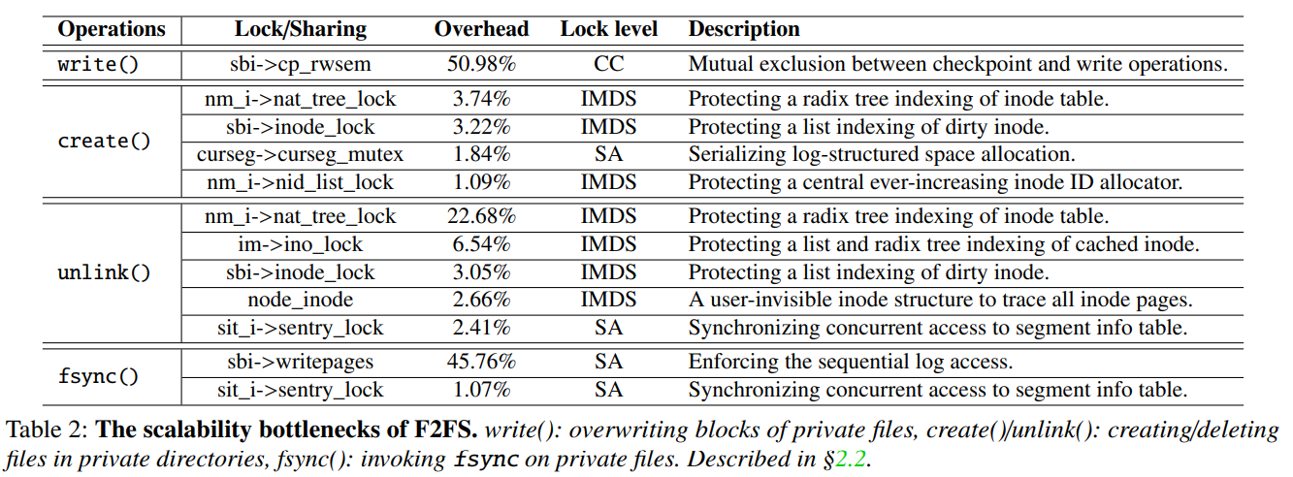
2. Motivation
What are the root causes of poor scalability in F2FS?
Lock contention from unscalable data structure cause CPU overhead
Lock level: Concurrency Control, In-Memory Data Structure, Space Allocation
51% CPU cycles for locking on write()
10% CPU cycles for locking on create()
37% CPU cycles for locking on unlink()
45% CPU cycles for locking on fsync()
Notes:
DRAM과 PCM, NAND간의 속도차이가 몇배가 나는지 설명

Slide 10

2. Motivation
What are the reasons for causing CPU overhead?
Concurrency Control
Cache coherence on the shared lock counter value
In-Memory
Data Structure
Serialization in accessing
the three radix trees
(FS metadata, File metadata, File data)
Space Allocation
One logical space allocator
Notes:
So, I will describe garbage Collection overhead in SSDs
As you all know, GC copies valid pages and reclaims free space. This results in write amplification, which has a significant impact on life and performance.
To reduce this overhead, a lot of research has been done in the past and there are examples A and B.

Slide 11
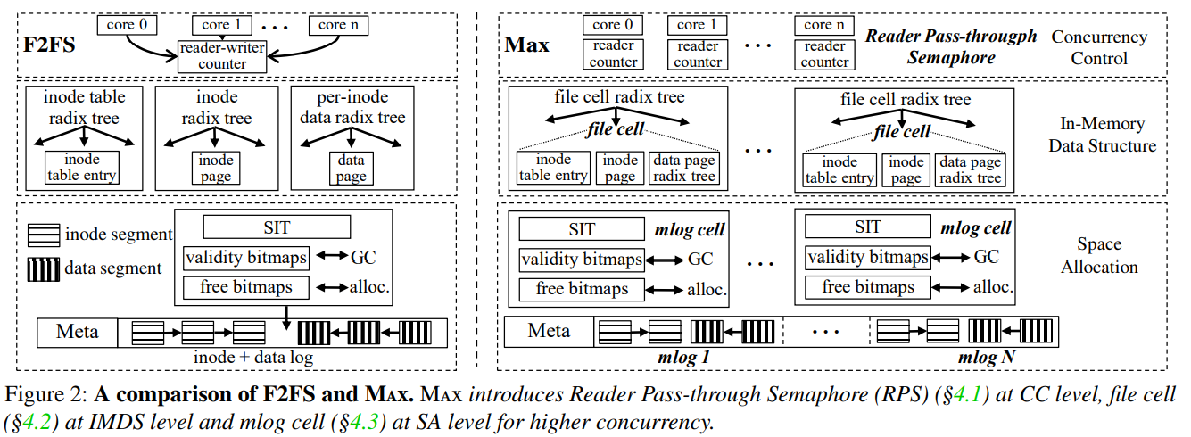
3. MAX
Overall Architecture
MAX
Notes:
기존 OS는 NVM을 효과적으로 이용할 수 없다.

Slide 12
3. MAX
Multicore-Accelerated File System
CC: Reader Pass-through Semaphore
IMDS: file cell
SA: mlog cell

Slide 13
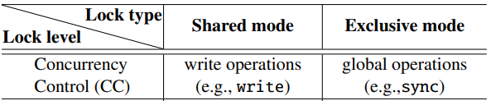
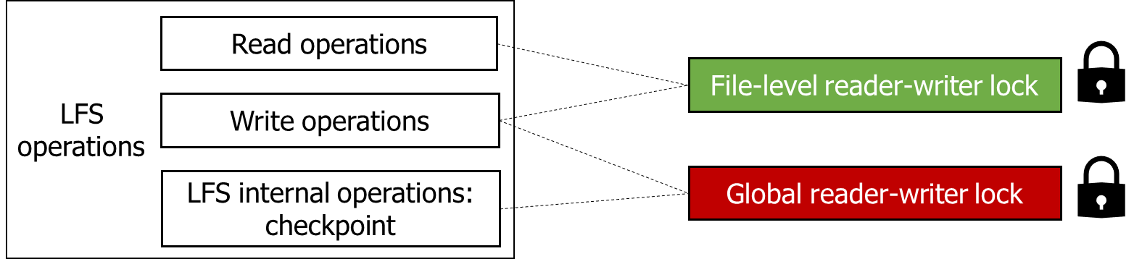
3. MAX
CC: Reader Pass-through Semaphore
Classic LFS’s concurrency control
Operations and concurreny control
Lock counter is shared among cores, so cache coherence can be severe with the scaling core
core 0
core 1
…
core n
Write requires a shared-mode lock
Checkpoint requires an exclusive-mode lock
Shared
counter
Shared counter
…
Shared
counter

Slide 14

3. MAX
CC: Reader Pass-through Semaphore
Concurrent readers: Per-core lock counters
Scheduler Free Rides: CPU scheduler checks per core counter value
write
write
core 0
core 1
…
core n
+1
+1
counter
counter
…
counter

Slide 15
3. MAX
CC: Reader Pass-through Semaphore
Concurrent readers: Per-core lock counters
Scheduler Free Rides: CPU scheduler checks per core counter value
write
write
core 0
core 1
…
core n
+1
+1
counter
counter
…
counter
Any write() are modifying the fs???
checkpoint

Slide 16
3. MAX
CC: Reader Pass-through Semaphore
Concurrent readers: Per-core lock counters
Scheduler Free Rides: CPU scheduler checks per core counter value
write
write
core 0
core 1
…
core n
+1
+1
counter
counter
…
counter
Any write() are modifying the fs???
checkpoint
aggressive polling
Scheduler-assisted check
lazy wait
: High overhead
: High latency and
slows the checkpoint

Slide 17


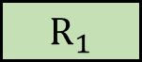





3. MAX
CC: Reader Pass-through Semaphore
The FS in kernel space frequently triggers CPU scheduler
Normal case
time
1
Core 1
1
Core 2
$$R_{i}$$
Reader
1
$$R_{1}$$
$$S$$
Core 3
$$W$$
Writer
$$W$$
Core 4
$$S$$
CPU
scheduler
Sleep
$$W$$
Per-core
Notification flag

Slide 18

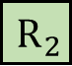
3. MAX
CC: Reader Pass-through Semaphore
The FS in kernel space frequently triggers CPU scheduler
Normal case
time
1
Core 1
$$R_{2}$$
Core 2
1
$$S$$
$$R_{i}$$
Reader
0
$$R_{1}$$
$$S$$
Core 3
$$W$$
Writer
$$W$$
Core 4
$$S$$
CPU
scheduler
Sleep
$$W$$
Per-core
Notification flag
$$R_{2}$$

Slide 19

3. MAX
CC: Reader Pass-through Semaphore
The FS in kernel space frequently triggers CPU scheduler
Normal case
time
$$S$$
1
Core 1
$$R_{2}$$
Core 2
0
$$S$$
$$R_{i}$$
Reader
0
$$R_{1}$$
$$S$$
Core 3
$$W$$
Writer
$$W$$
Core 4
$$S$$
CPU
scheduler
Sleep
$$W$$
Per-core
Notification flag
$$R_{2}$$

Slide 20


3. MAX
CC: Reader Pass-through Semaphore
The FS in kernel space frequently triggers CPU scheduler
Normal case
time
$$S$$
0
Core 1
$$R_{2}$$
$$R_{2}$$
Core 2
0
$$S$$
$$R_{i}$$
Reader
0
$$R_{1}$$
$$S$$
Core 3
$$W$$
Writer
$$W$$
$$W$$
Core 4
$$S$$
CPU
scheduler
Sleep
$$W$$
Per-core
Notification flag
$$R_{2}$$

Slide 21
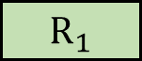



3. MAX
CC: Reader Pass-through Semaphore
The FS in kernel space frequently triggers CPU scheduler
2) Corner case: late preemption, task migration
time
1
Core 1
$$R_{i}$$
Migratory reader
Core 2
1
$$R_{2}$$
$$R_{i}$$
Reader
1
$$S$$
Core 3
$$R_{1}$$
$$W$$
Writer
$$W$$
Core 4
$$S$$
CPU
scheduler
Sleep
$$W$$
Per-core
Notification flag

Slide 22

3. MAX
CC: Reader Pass-through Semaphore
The FS in kernel space frequently triggers CPU scheduler
2) Corner case: late preemption, task migration
time
1
Core 1
$$R_{i}$$
Migratory reader
Core 2
1
$$R_{2}$$
$$R_{i}$$
Reader
0
$$S$$
Core 3
$$R_{1}$$
$$W$$
Writer
$$W$$
Core 4
$$S$$
CPU
scheduler
Sleep
$$W$$
Per-core
Notification flag
$$R_{2}$$

Slide 23


3. MAX
CC: Reader Pass-through Semaphore
The FS in kernel space frequently triggers CPU scheduler
2) Corner case: late preemption, task migration
time
Core 1
1
$$S$$
$$R_{i}$$
Migratory reader
Core 2
0
$$R_{2}$$
$$R_{i}$$
Reader
0
$$S$$
Core 3
$$R_{1}$$
$$W$$
Writer
$$W$$
$$W$$
Core 4
$$S$$
CPU
scheduler
Sleep
$$W$$
Per-core
Notification flag
$$R_{2}$$

Slide 24



3. MAX
CC: Reader Pass-through Semaphore
The FS in kernel space frequently triggers CPU scheduler
2) Corner case: late preemption, task migration
time
$$R_{2}$$
Core 1
0
$$S$$
$$R_{i}$$
Migratory reader
Core 2
0
$$R_{2}$$
$$R_{i}$$
Reader
0
$$S$$
Core 3
$$R_{1}$$
$$W$$
Writer
$$W$$
$$W$$
$$W$$
Core 4
$$S$$
CPU
scheduler
Sleep
$$W$$
$$W$$
Per-core
Notification flag
$$R_{2}$$

Slide 25
3. MAX
Multicore-Accelerated File System
CC: Reader Pass-through Semaphore
IMDS: File Cell
SA: mlog cell

Slide 26
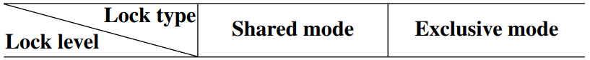
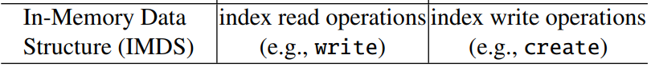


3. MAX
IMDS: File Cell
Partition and reorganize in-memory data structure
Encompasses inode table entry, inode page, data page
Places each file cell to a tree by hashing the inode ID
File cell group 0
File cell group N
…
Inode number % N =0
Inode number % N =N-1
write(), read(), stat(), fsync():
Lock group/indexing in shared-mode
Lock file cell of target file
File operations
File
cell
9 B
file 1 inode table
4 KB
inode
4 KB
File 1 data

Slide 27

3. MAX
IMDS: File Cell
Partition and reorganize in-memory data structure
Encompasses inode table entry, inode page, data page
Places each file cell to a tree by hashing the inode ID
File cell group 0
File cell group N
…
Inode number % N =0
Inode number % N =N-1
write(), read(), stat(), fsync():
Lock group/indexing in shared-mode
Lock file cell of target file
File operations
File
cell
9 B
file 1 inode table
create(), unlink(), mkdir():
Lock group/indexing in exclusive-mode
Lock file cell of target files and directory
File operations
4 KB
inode
4 KB
File 1 data

Slide 28
3. MAX
Multicore-Accelerated File System
CC: Reader Pass-through Semaphore
IMDS: File Cell
SA: mlog cell

Slide 29
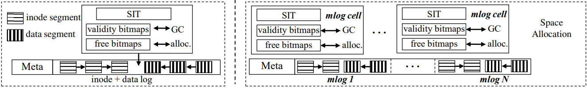
3. MAX
SA: Mlog Cell
write(file1)
create(file1)
dispatch atomic file operations in a round-robin fashion
each mlog maintains its internal consistency
mlog 1
mlog 2
mlog 3
How to keep consistency over multiple mlog?
inode
Write(file1)
rename(file1, file2)
Use a global version
number to decide the
persistence ordering
mlog 1
mlog 2

Slide 30

3. MAX
Summary
Concurrency Control
Reader Pass-through Semaphore
In-Memory
Data Structure
File cell to scale the access to IMDS
(FS metadata, File metadata, File data)
Space Allocation
Mlog for concurrent SA and persistence
Notes:
So, I will describe garbage Collection overhead in SSDs
As you all know, GC copies valid pages and reclaims free space. This results in write amplification, which has a significant impact on life and performance.
To reduce this overhead, a lot of research has been done in the past and there are examples A and B.

Slide 31
4. Evaluation
Evaluation Environment
CPU | 4 Intel Xeon Gold 6140 CPU, each with 18 physical cores (total: 72 CPU cores)
Memory | 250 GB DRAM (only 10% DRAM used for page cache)
OS | Linux vanilla kernel 4.19.11
Filesystem | Ext4 / XFS / F2FS / SpanFS / MAX
Device | Intel DC P3700 SSD
Workloads | 1) Data and metadata scalability 2) Varmail and RocksDB 3) Upper bound evaluation against tmpfs

Slide 32
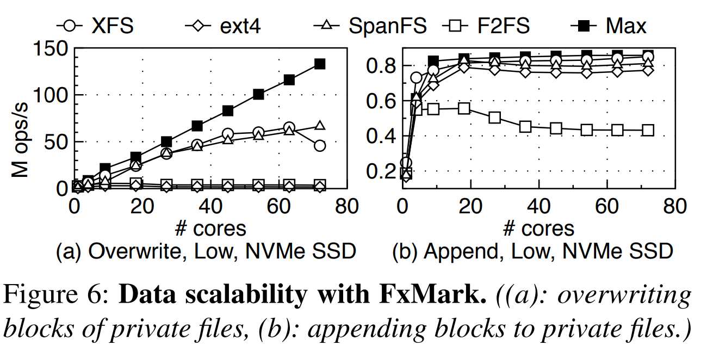
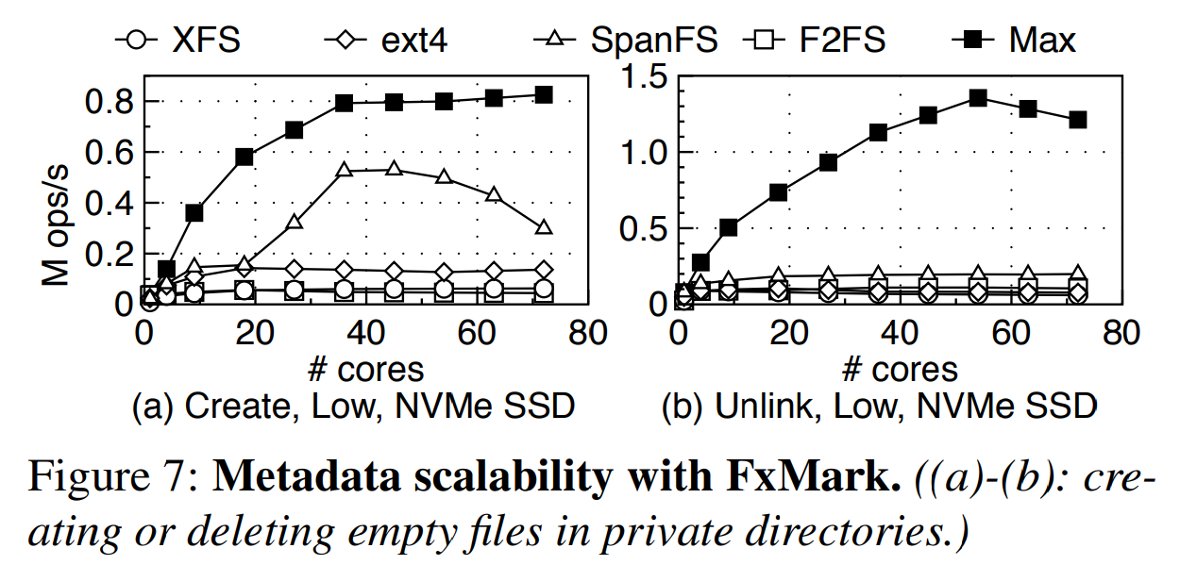
4. Evaluation
File Operation
MAX = 35 x F2FS in overwrite,
= 2 x F2FS in append
MAX = 18.6 x F2FS in create,
= 11.5 x F2FS in unlink
Notes:
So, I will describe garbage Collection overhead in SSDs
As you all know, GC copies valid pages and reclaims free space. This results in write amplification, which has a significant impact on life and performance.
To reduce this overhead, a lot of research has been done in the past and there are examples A and B.

Slide 33
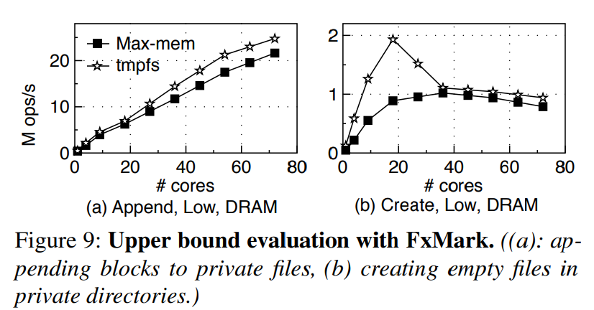
4. Evaluation
Max-mem Performance
Max-mem: disable fsync and page cache flushes to avoid duplicate on-disk copy
tmpfs: a simple wrapper of Linux VFS, a memory-based file system
Tested device: 20GB memory-backed RAMdisk
The throughput of Max-mem comes close to tmpfs
Notes:
So, I will describe garbage Collection overhead in SSDs
As you all know, GC copies valid pages and reclaims free space. This results in write amplification, which has a significant impact on life and performance.
To reduce this overhead, a lot of research has been done in the past and there are examples A and B.

Slide 34
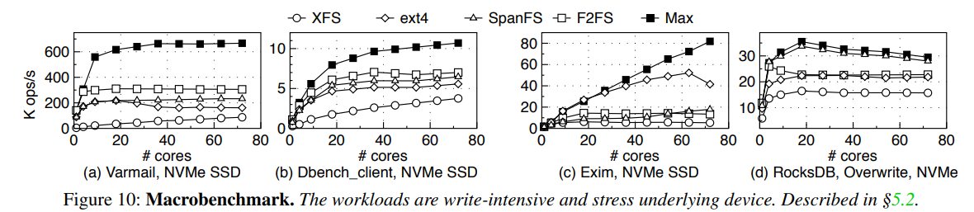
4. Evaluation
Macrobenchmark
MAX performs best among all tested file system
Notes:
So, I will describe garbage Collection overhead in SSDs
As you all know, GC copies valid pages and reclaims free space. This results in write amplification, which has a significant impact on life and performance.
To reduce this overhead, a lot of research has been done in the past and there are examples A and B.

Slide 35
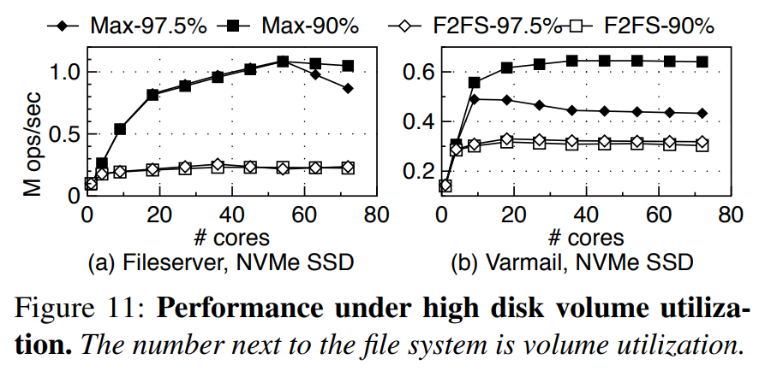
4. Evaluation
High volume utilization
MAX outperforms F2FS in Fileserver and varmail
Notes:
So, I will describe garbage Collection overhead in SSDs
As you all know, GC copies valid pages and reclaims free space. This results in write amplification, which has a significant impact on life and performance.
To reduce this overhead, a lot of research has been done in the past and there are examples A and B.

Slide 36

5. Conclusion
MAX
Reader Pass-through semaphore for CC, file cell for IMDS and mlog for SA
Outperforms modern Linux file systems
Offers multicore scalability and fully exploits the bandwidth of NVMe SSD
https://github.com/thustorage/max
core
core
core
core
core
core
core
core
core
core
core
core
core
core

Slide 37
MAX : A Multicore-Accelerated File System for Flash Storage
Xiaojian Liao, Youyou Lu, Erci Xu, Jiwu Shu,
In 2021 USENIX Annual Technical Conference
Thank You!
2021. 08. 30
Presentation by Han, Yejin
hyj0225@dankook.ac.kr
Notes:
Let me begin my presentation.
Today I will give a presentation on “Fully Automatic Stream Management for Multi-Streamed SSDs Using Program Contexts”

